Slide 1



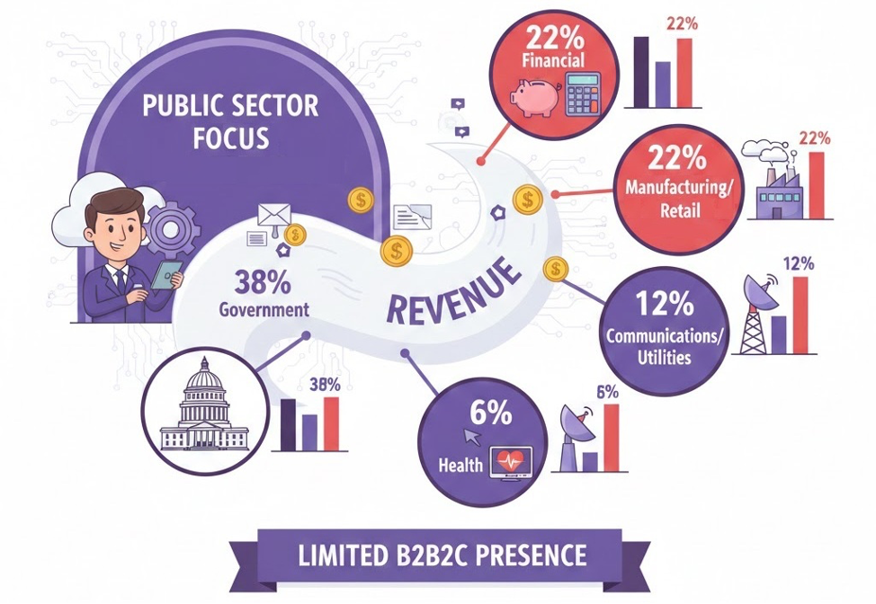


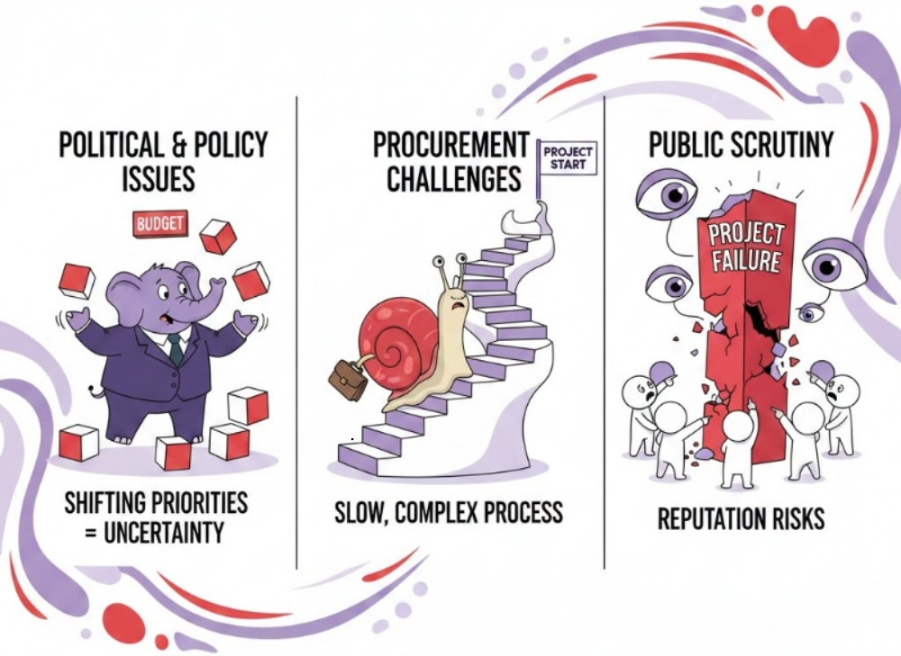

Digital Health Companion Initial Presentation
Pentagon Nexus Consulting Group
Simon Sarkodie, Mohana Dutta, Ya-Jwu Jang, Meet Patel, Vasukrishna Bhalodia
Introduction
1. Continuous Health Monitoring: Real-time vitals tracked through connected wearables and shared instantly with healthcare providers.
4. Provider & Customer Connectivity: Secure messaging bridges patients and healthcare providers for quick guidance and support.
Phase 2 – controlled rollout
Expand access to multiple healthcare partners.
Monitor defects, user adoption, and security logs.
Improve performance and scalability.
Phase 3 – Full nationwide deployment
Launch bilingual support (English/French).
Achieve 99.9% availability and < 2-second response time.
Go-live monitoring and support escalation.
Post Go-live
Monthly performance reviews.
Quarterly compliance audits.
Continuous AI model tuning with medical oversight.
A reputable IT consultancy firm relies heavily on government-sector digital projects for stable revenue. Our team analyzed how a Digital Health Companion App could unlock new commercial pathways and solve market limitations.
Current State
The firm’s projects are tied to public-sector contracts for most of its revenue. Technical skills are strong, but limited B2B2C presence.
Cost
2. Integration Components: Multiple wearable devices sync seamlessly with the mobile health platform for unified data flow.
5. Secure Communication: Encrypted messaging enables safe, seamless communication between patients and healthcare providers.
 | Year 1 | Year 2 | Year 3 | Year 4 | Year 5
Total Cost | $1,080,000 | $190000 | $200,000 | $210,000 | $220,000
Total Benefits | $50,000 | $600,000 | $900,000 | $1,100,000 | $1,250,000
Net Benefit | –$1,030,000 | $410,000 | $700,000 | $890,000 | $1,030,000
ROI | -47% | 18% | 47% | 78% | 105%
Pain Points
Financial performance:
Positive ROI of 105% over 5 years
Net Benefit grows to $1,030,000 by Year 5
Payback period ≈ 2.5 years
Political shifts create revenue uncertainty, slow procurement processes delay projects, and any high-profile government project failures lead to reputational damage for the organization.
Risk and Mitigation Strategy
Risk Description | Impact | Mitigation Strategy
Wrong vitals due to sensor or Bluetooth issues | High | Add accuracy checks and test devices regularly
Battery drains quickly | Medium | Optimize background use; let users adjust update frequency
Wearable updates break syncing | High | Test after each device update; keep SDKs updated
Missed reminders cause non‑adherence | High | Improve reminder reliability; enable SMS/email backup alerts
Chat/messages fail during peak load | High | Use cloud auto-scaling and retry logic
AI gives wrong or confusing advice | High | Review AI outputs; include a clear disclaimer
3. Medication & Care Plan Reminders: Automated alerts ensure timely medication intake and adherence to personalized care plans.
Benefits and Impacts
Diversified Revenue: Expands beyond government projects and enables scalable, subscription-based income.
Stronger Digital Health Presence: Establishes a visible, consumer-facing role in the digital health ecosystem.
Accelerated Innovation: Drives modernization through AI insights, wearable integration, and interoperability.
Scalable Product Model: Moves from custom project delivery to a reusable, high-scalability digital product.
Implementation plan
Conclusion
Solution
Phase 1 – pilot launch
Release to one hospital and a small patient group.
Validate wearable integration and AI accuracy.
Ensure compliance with HIPAA, PHIPA, and GDPR.
Embracing the digital health companion app marks a vital step. By moving into private sector markets, the company can build stronger partnerships, gain new sources of revenue, and grow its reputation beyond government work. The journey ahead is promising, and the team is committed to making every transition smooth and successful.
Relying on a single sector’s limits progress and individuals feel that gap everyday. Our approach widens the impact, delivering accessible digital health support while unlocking long-term growth.

